Slide 1


Book Recommendation System(P-187)
The project done by Group 6
Group 6 consist of following members:
Madan K
Kuldeep Mishra
Vansh Shyam Shrivastava
Md Awaiz
Sohail Hanif Bachne
Mukesh Avatar Madesia

Slide 2







Flow of the Presentation
• Introduction
• Data Preparation
• EDA
• Model Building
• Model Evaluation
• Deployment

Slide 3
INTRODUCTION
A recommendation system is a tool used to predict what a user may be interested in based on their previous actions or interactions. It is commonly used in e-commerce, media, and social media platforms to recommend products, music, movies, articles, or friends to users.
Types of recommendation systems:
Collaborative Filtering: This method makes recommendations based on the behavior of similar users. It compares the preferences of one user to other users and suggests items that similar users have liked.
Content-Based Filtering: This method makes recommendations based on the properties of the items. It suggests items that are similar to ones that the user has previously liked.
Hybrid Recommendation Systems: This method combines the benefits of both collaborative and content-based filtering. It uses the user's past interactions with the system, as well as the characteristics of the items, to make recommendations.
Recommendation systems can be implemented using various techniques such as Singular Value Decomposition (SVD), k-Nearest Neighbors (k-NN), and deep learning algorithms like Neural Networks.
Overall, recommendation systems can improve user engagement and increase sales by providing personalized and relevant recommendations to users.

Slide 4
Objective: On the basis of the given datasets that contain the required records, we need to build a Machine Learning (ML) model to recommend book(s).
Methodology: Unsupervised Machine Learning (ML)
Database Summary:
Three datasets are being provided:
1. Books: with 271360 rows and 8 columns it contains details about book.
2. Users: with 278858 rows and 3 columns it contains details about users.
3. Ratings: with 1048575 and 3 columns it contains details about the ratings given to a book by users.

Slide 5
DATA PREPARATION
Books Dataset: It contains the given 8 columns
1. ISBN – International Standard Book Number, an identification number of book.
2. Book-Title – Name of the book
3. Book-Author – Author of the book
4. Year-of-Publication – Year when the book was published
5. Publisher – Name of the Publisher
6. Image-URL-S
7. Image-URL-M
8. Image-URL-L 6, 7, 8 contain the link to the image of the cover of the book
Users Dataset: It contains the given 3 columns
1. User-ID – ID number of the user
2. Location – Location (City, Province/State, Country) of the user
3. Age – Age of the user
Rating Dataset: It contains the given 3 columns
1. User-ID – ID number of the user
2. ISBN – International Standard Book Number, an identification number of book.
3. Book-Rating – Rating is given by the user to the book

Slide 6
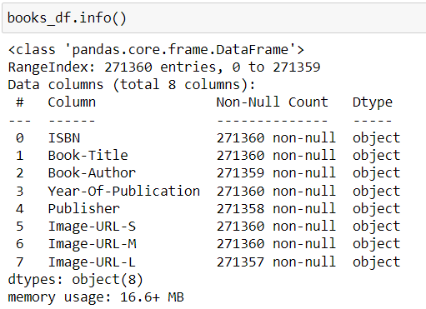
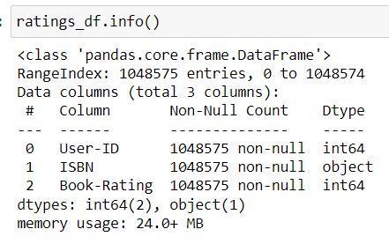
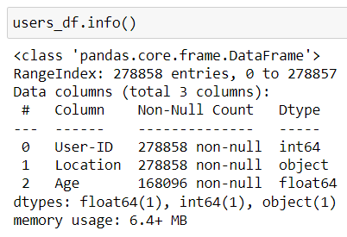
Overview of Datasets
Books Dataset: Some columns have 1 or 2 missing values so those entries were deleted.
Users Dataset: It has 40% of null values in the ‘Age’ column approx.
Rating Dataset: It doesn’t have any null values in any column
Books Dataset
Users Dataset
Ratings Dataset

Slide 7
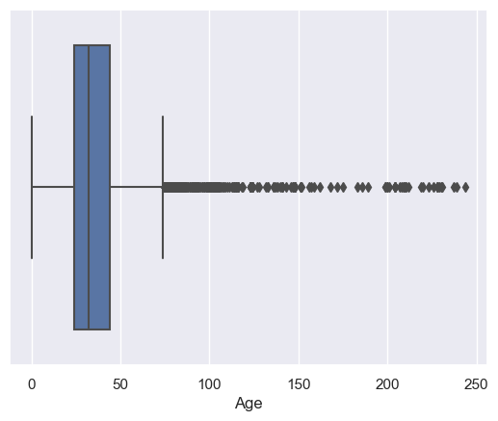
EDA
Age column Null imputation
As we can see that in Age column approximately there are 40% of Null values
If there are a high percentage of missing values in the Age column, replacing the missing values with the mean or median may not be appropriate. This is because the mean or median of the non-missing values may not be a good representation of the missing values.
If a high percentage of the data is missing, it can skew the mean or median, making it a less accurate representation of the population.
Null values are imputed by mean of age column.
Age column contains lots of outliers and positively skewed
Categorizing the age column by 'Children', 'Teenage', 'Young-adults','Middle-aged adults','Old-Aged adults','Very-Aged adults'
bin_edges = [0, 12, 20, 40, 60, 100,120]
bin_names = ['Children', 'Teenage', 'Young-adults', 'Middle-aged adults', 'Old-Aged adults', 'Very-Aged adults']
df['Age_category'] = pd.cut(df['Age'], bin_edges, labels=bin_names)

Slide 8
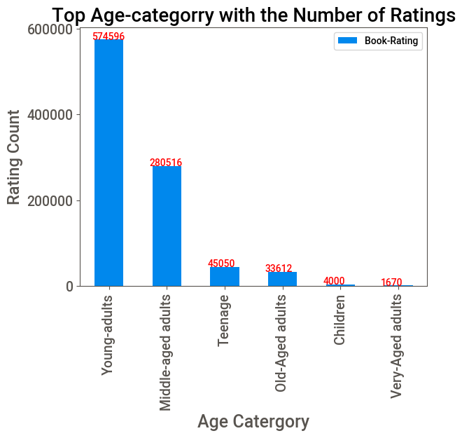
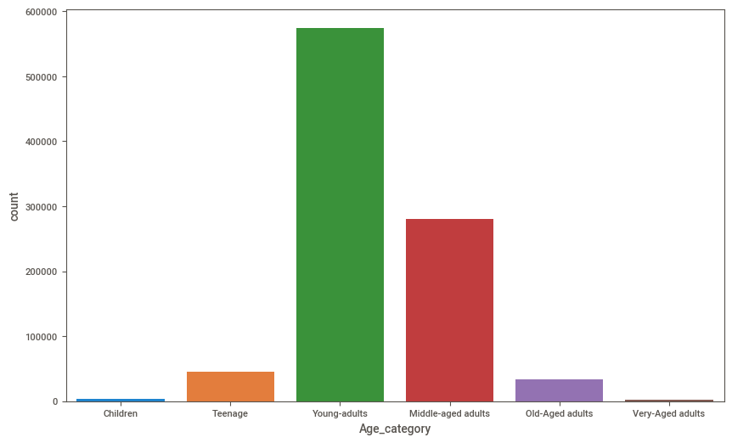
Most no of book users are Young adults followed by middle age adults
Least no of book users are very age adults

Slide 9
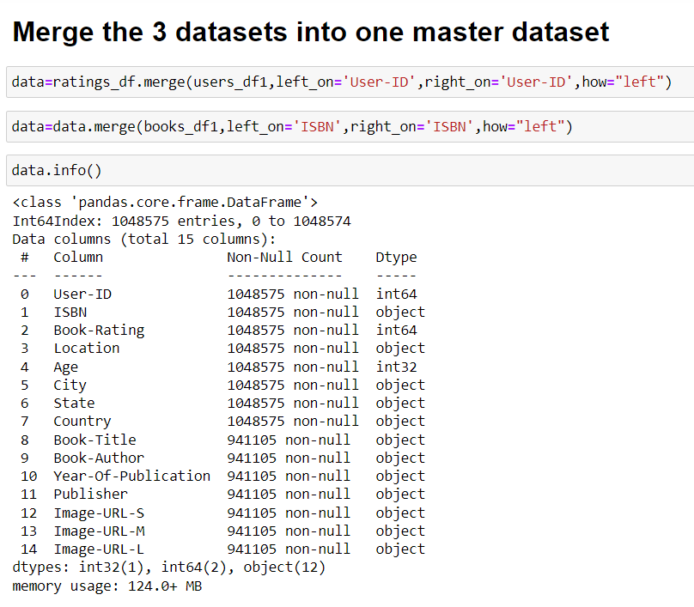
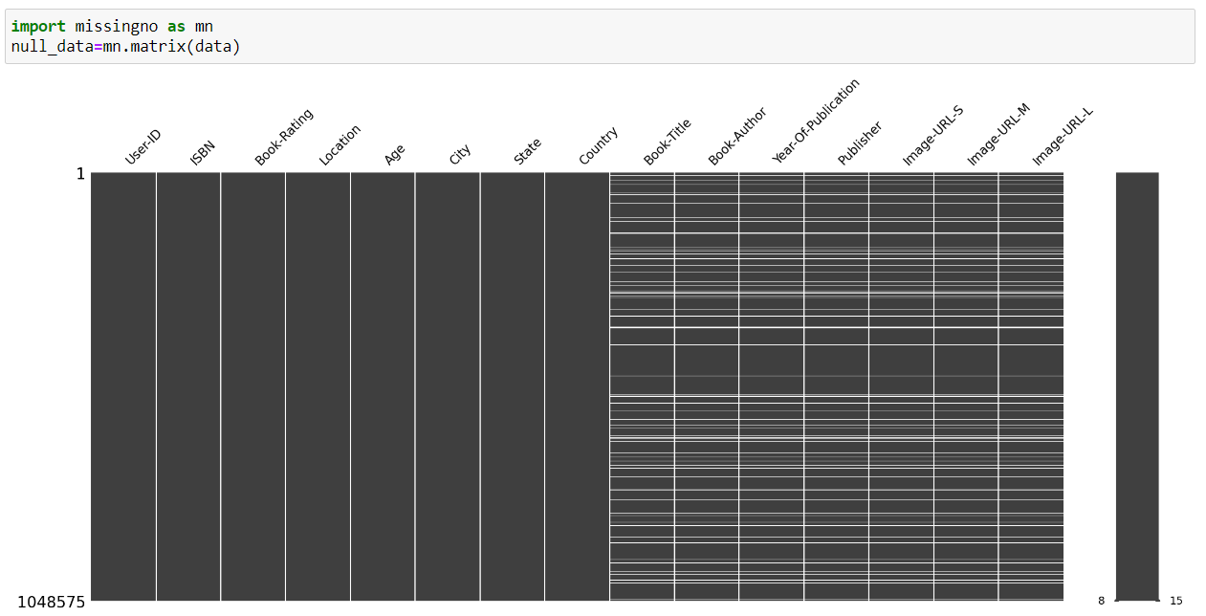
We started merging all three datasets into one master dataset
We can see that there are null values in column book-title,book-author,year of publication,image-S,image-M,image-L,so we drop those records from the dataset

Slide 10
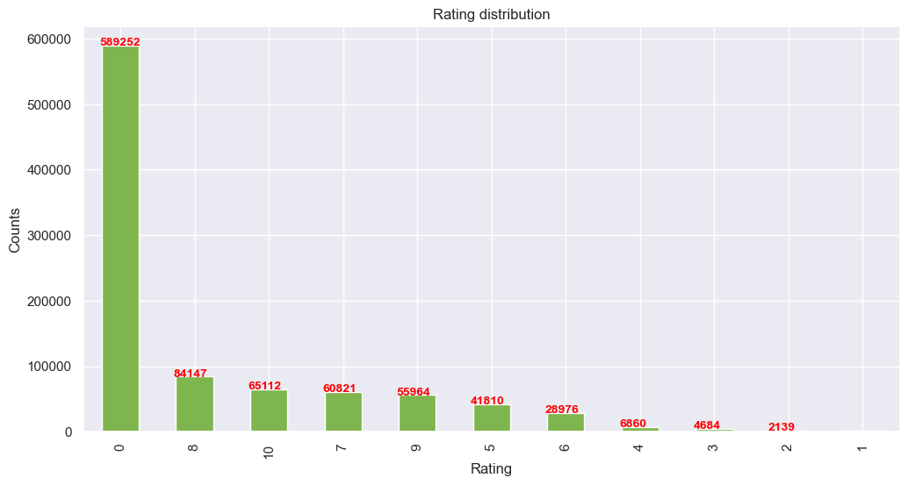
Rating distribution
It can be noted that a significant number of book titles have received a rating of '0' from users. In this scenario, it would be beneficial to retain these book titles with a rating of '0' as it can help segment the data based on popularity. Furthermore,
it can be observed that the rating of '0' is the most frequently given by users, while the rating of '2' is the least frequently given.

Slide 11
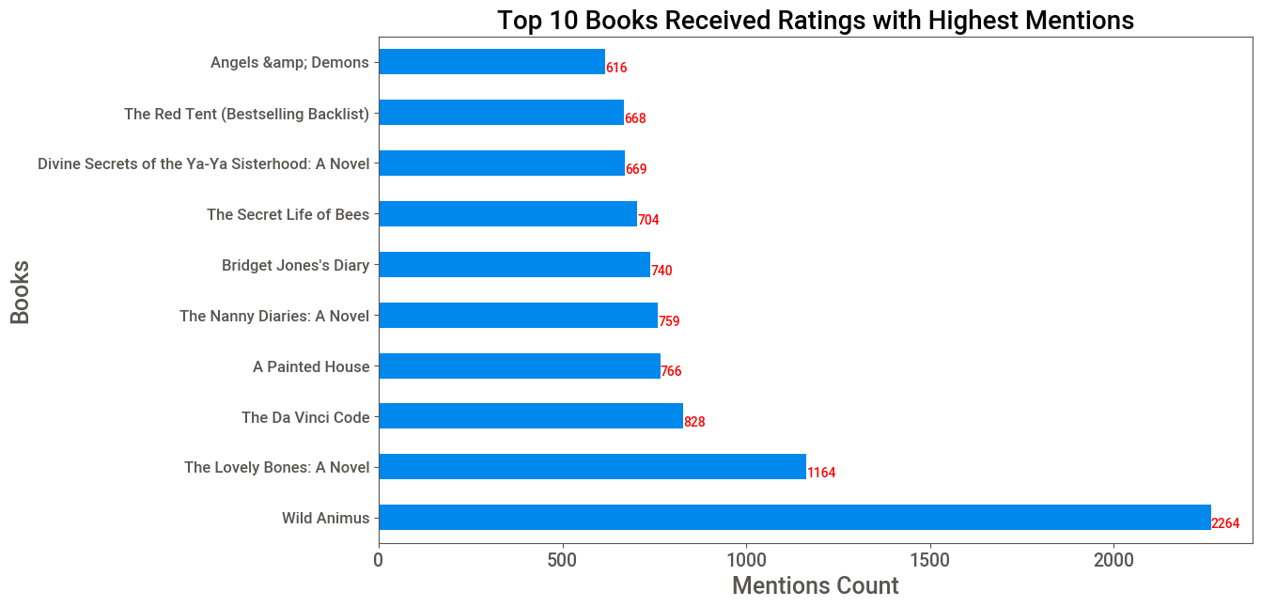
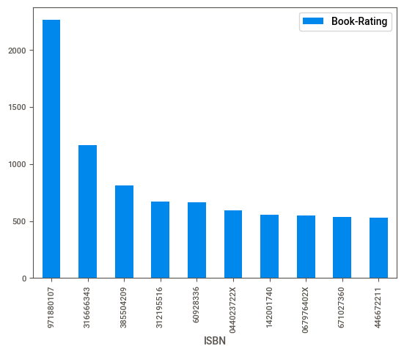
About books
‘Wild Animus’ has the highest mentions, ‘Bridget Jones’s Diary’ and ‘The Lovely Bones: A Novel’ are 2nd and 3rd highest mentioned books.
book-code 971880107 has received most no of ratings

Slide 12
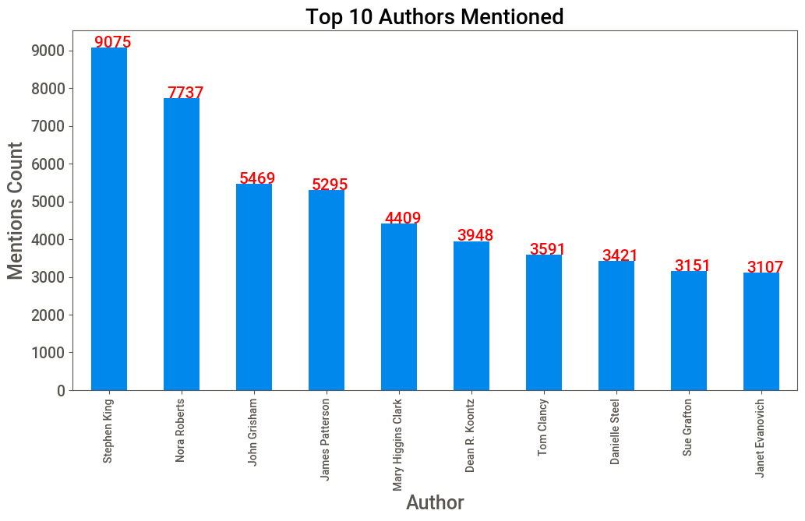
About Authors
Stephen King has the highest mentions, Nora Roberts and John Grisham are 2nd and 3rd respectively.

Slide 13
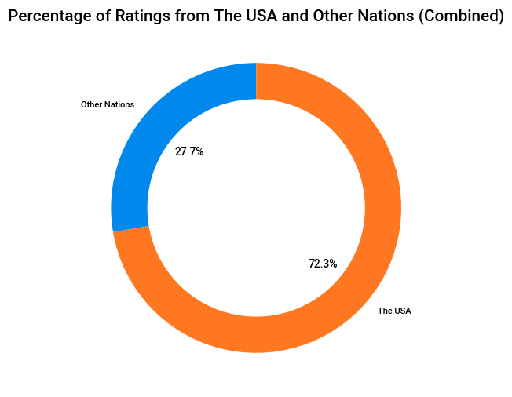
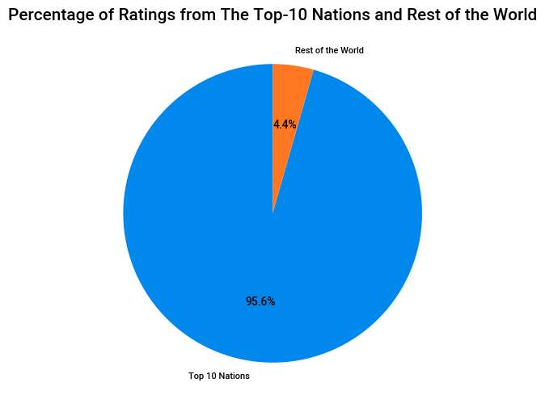
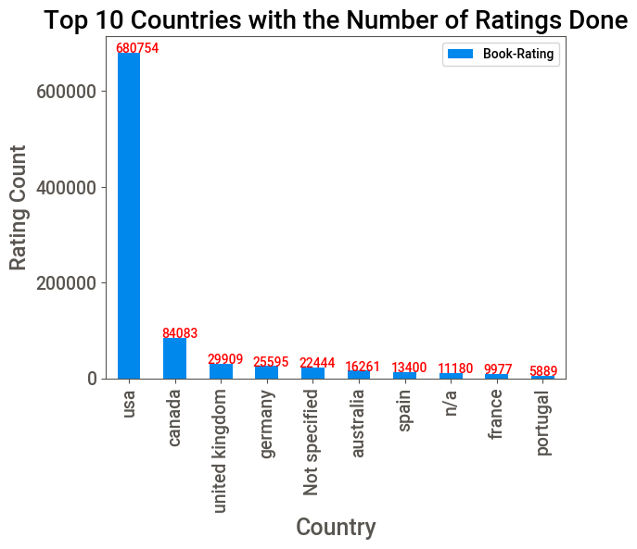
About Location
• The USA is the dominating origin of ratings. • Nearly 1 in 3 ratings were done from The USA. • 3 in 4 ratings among top 10 nations are American and European nations.

Slide 14
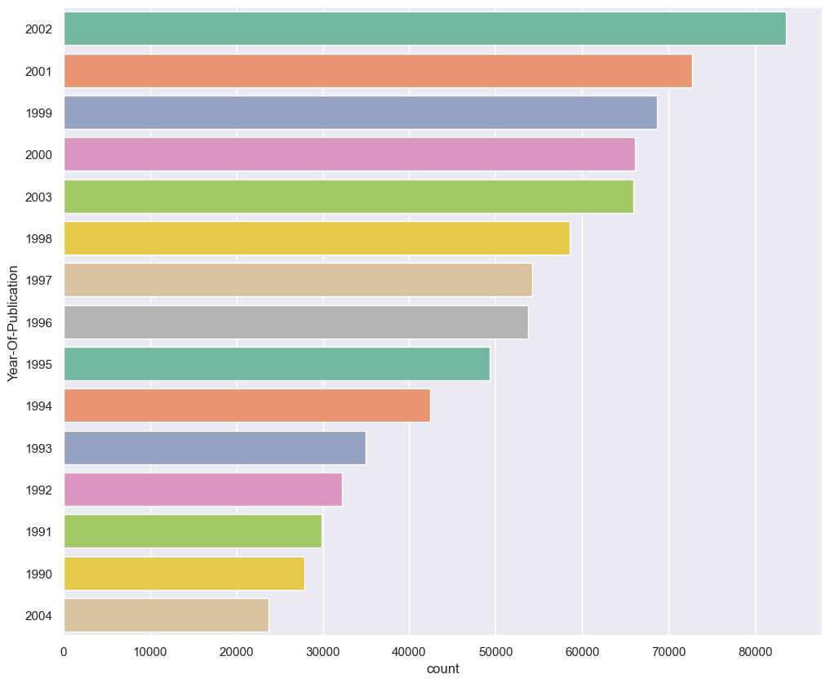
No of books published as per year
Most no of books got published in year 2002,more than 80,000 books got published
Least no of books published in year 2004, more than 20,000 books got published

Slide 15
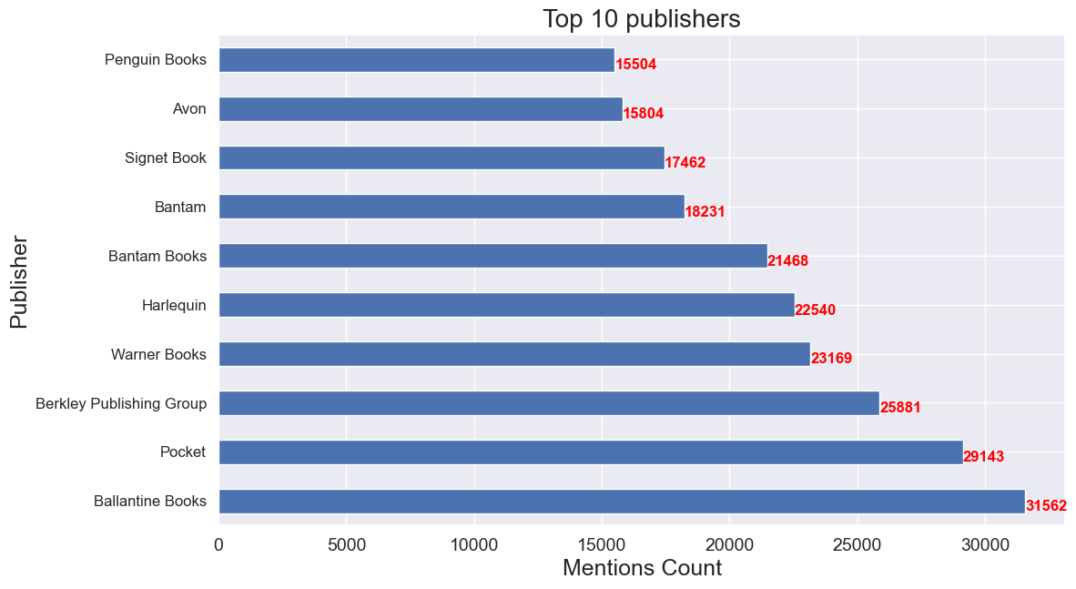
No of books published as per year
Ballantine books has published 31562 no of books followed by pocket and Berkley publishing group

Slide 16
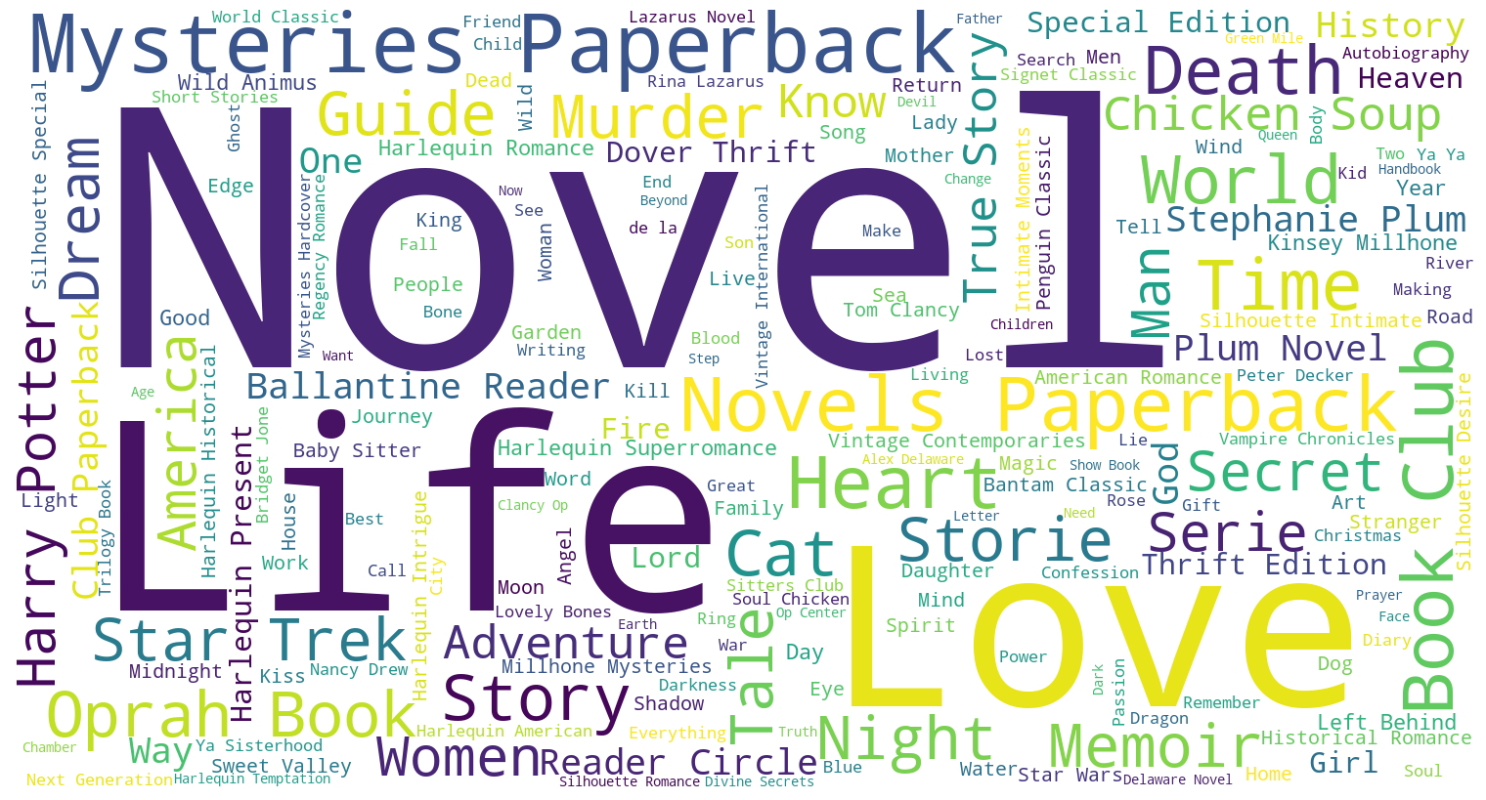
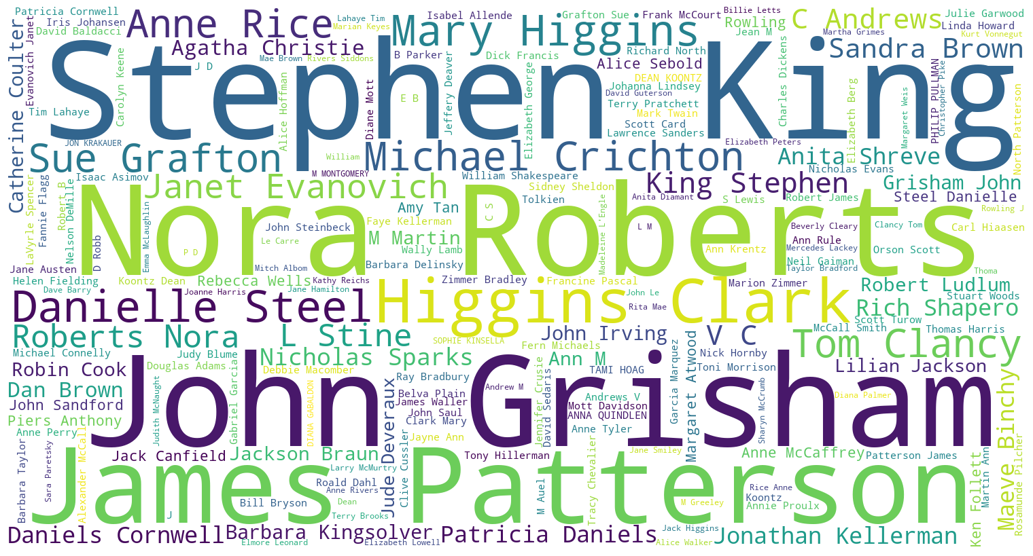
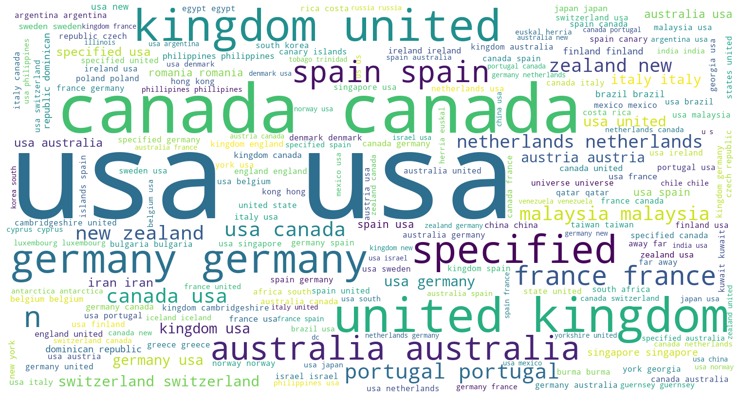
WORD CLOUD
Book-Title
Book-Author
Book-Title
Most frequently occurred words in book titles are Novel,life,love
Book-Author
Most frequently occurred words are Stephen king,nora Roberts,john grisham,james patterson
Country
Most frequently occurred words in country are usa,uk,canasa,spain.
Country

Slide 17
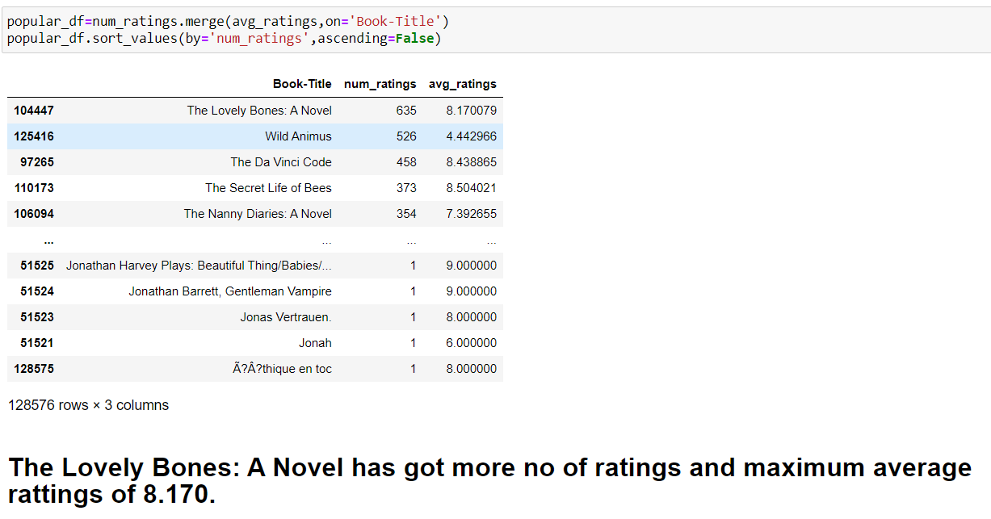
Algorithm Implementation
1]POPULARITY BASED
2]CONTENT BASED FILTERING
3]USER BASED FILTERING
POPULARITY BASED

Slide 18
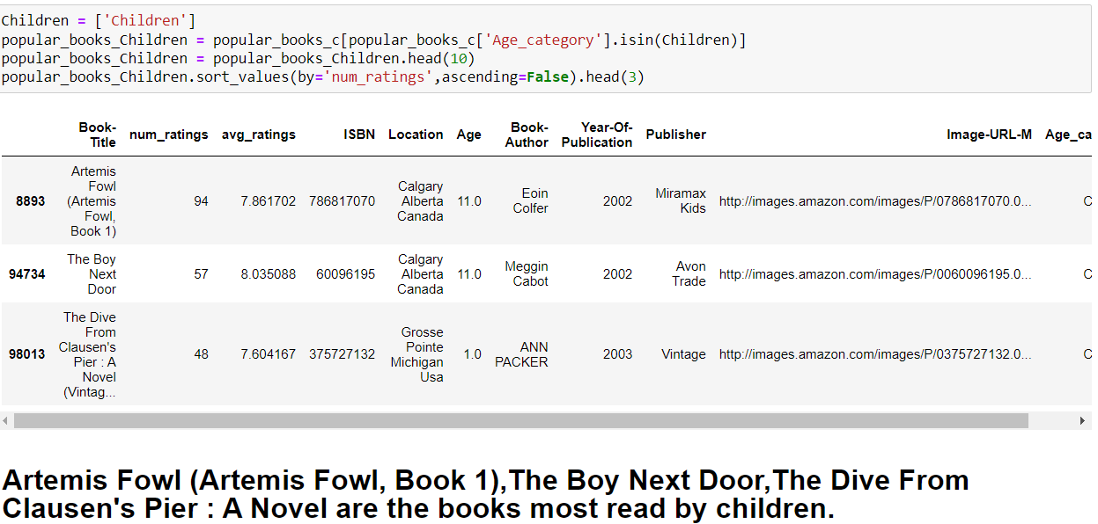
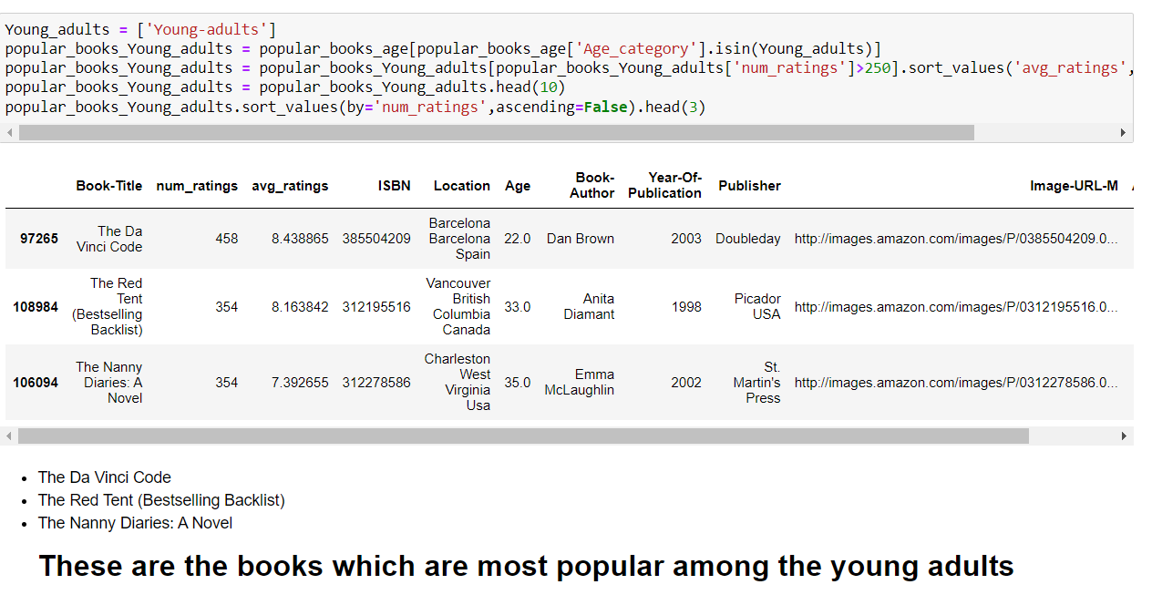
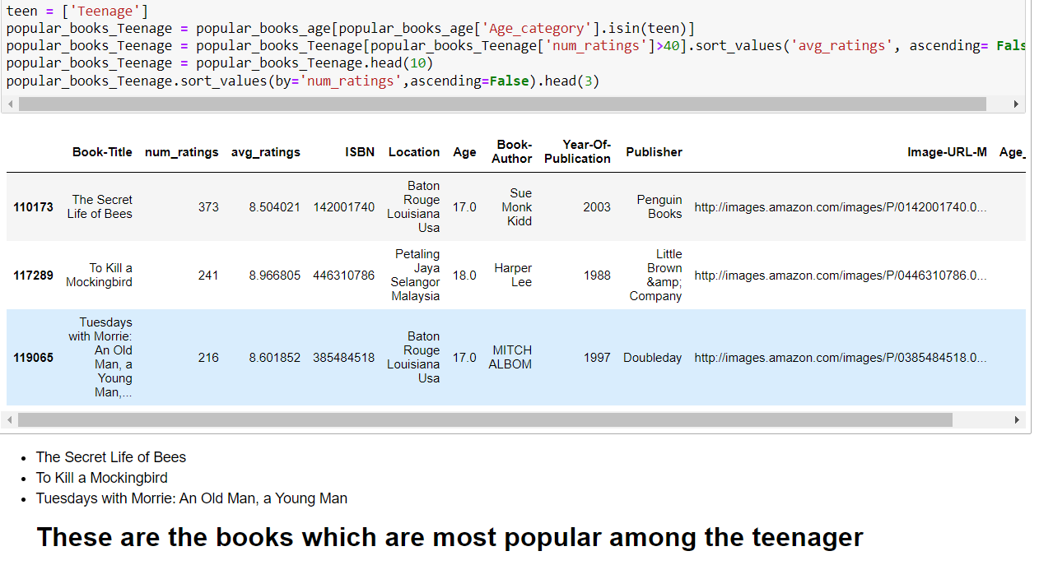
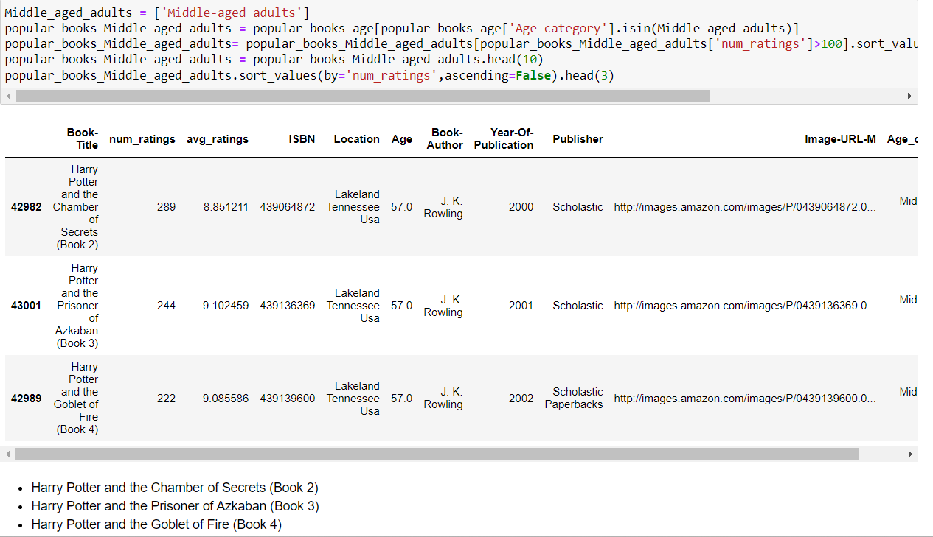
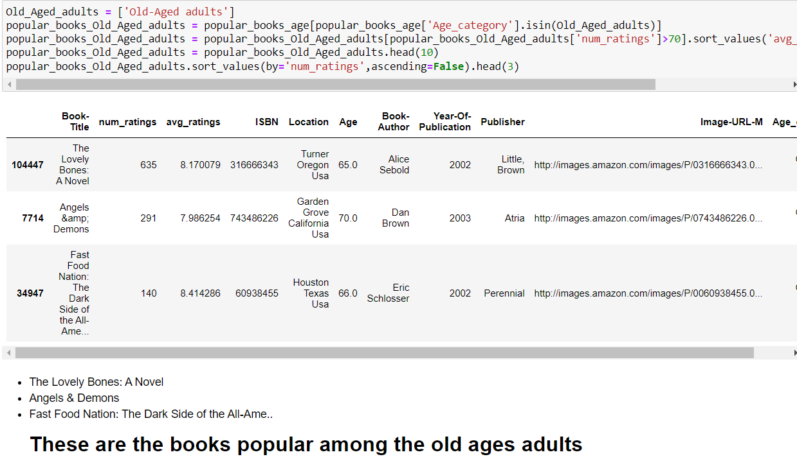
Children
POPULARITY AMONG AGE CATEGORY
Young Adults
Teenager
Middle aged adults
Old Aged adults

Slide 19
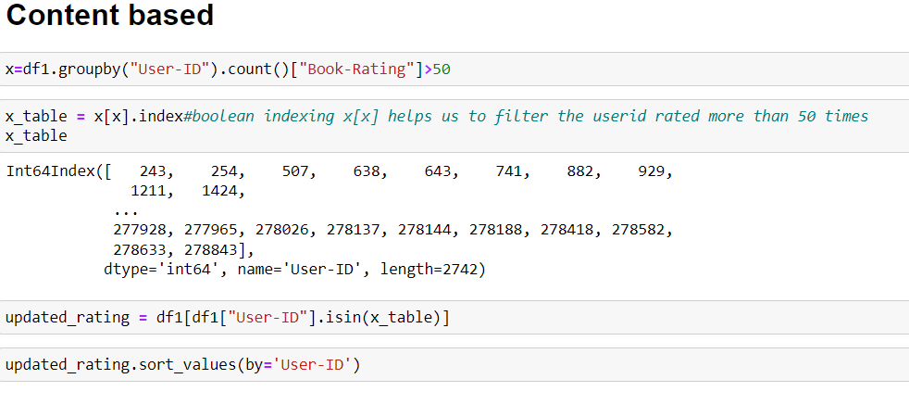
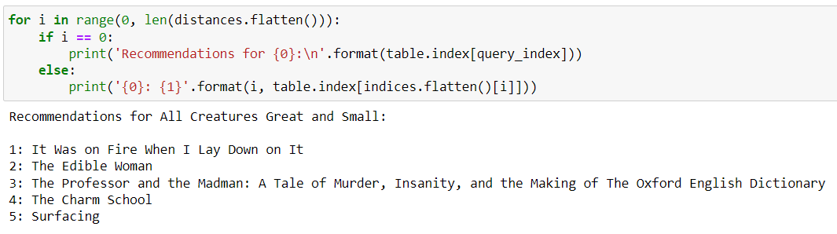
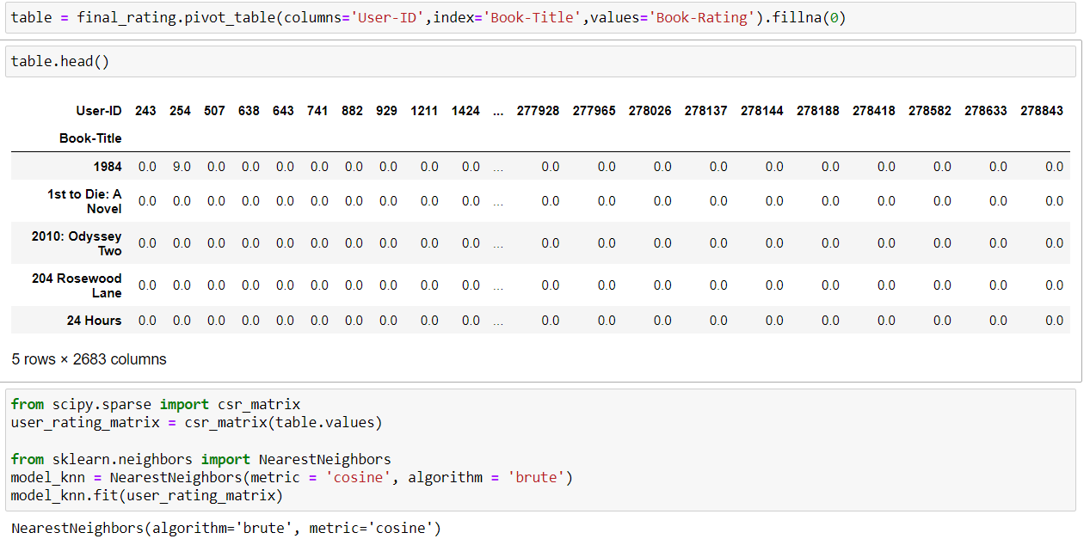
CONTENT BASED FILTERING
Steps Involved after finalizing dataset:
Step1:Filtering the dataset based on user and book title by rating grater than 50.
Step3:Making Sparse Matrix and implementing the algorithm
Step2:Creating the pivot table

Slide 20
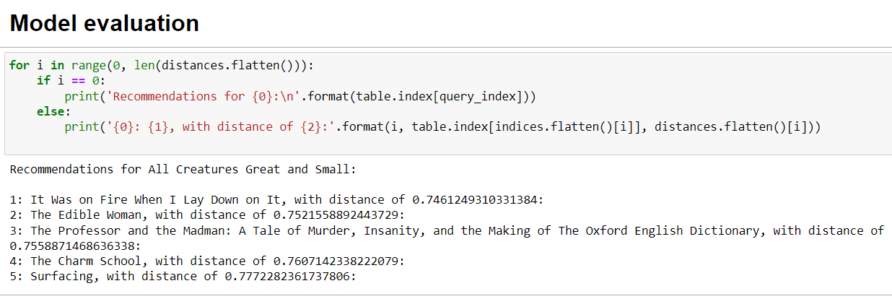
Step4:Testing Result

Slide 21
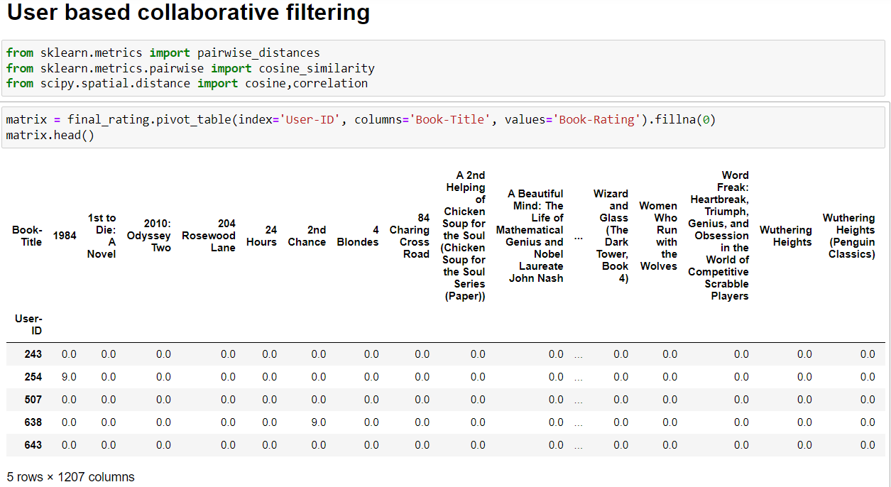
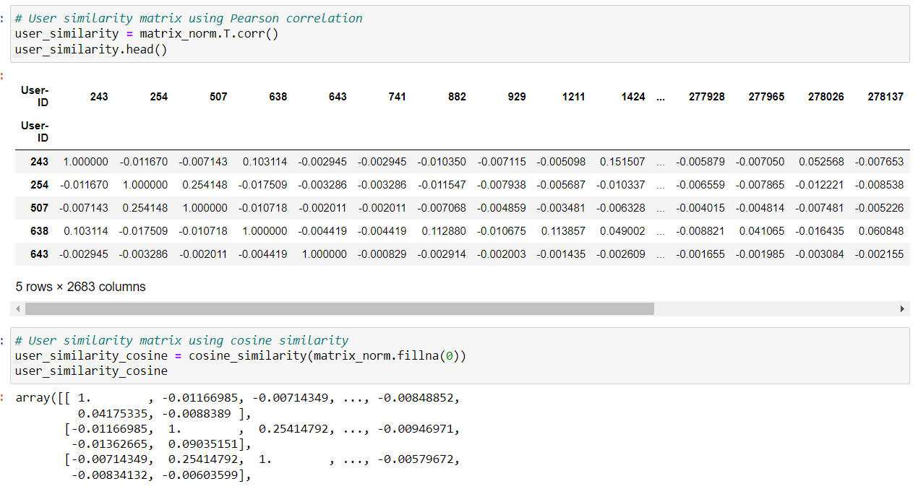
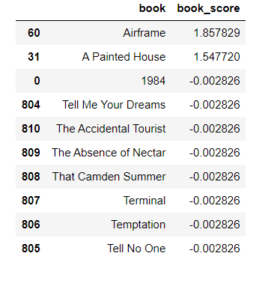
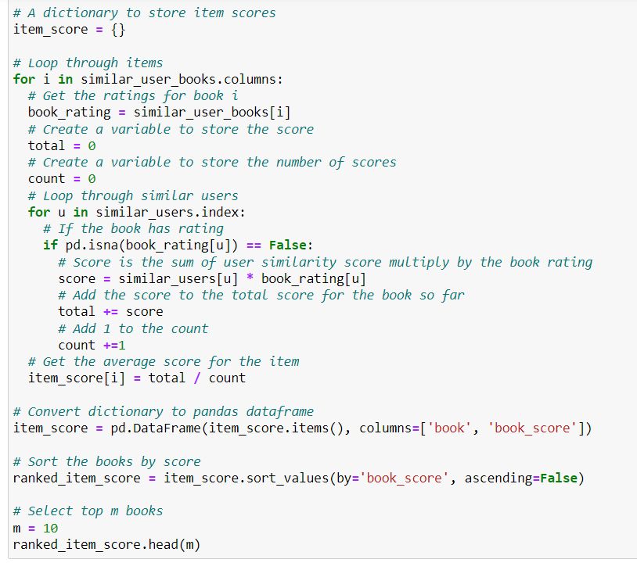
User BASED FILTERING
Step1:Creating the pivot table
Step2:Creating the similarity matrix
Step3:Defining the function using similarity score to find the similar books
Step4:Model Testing

Slide 22
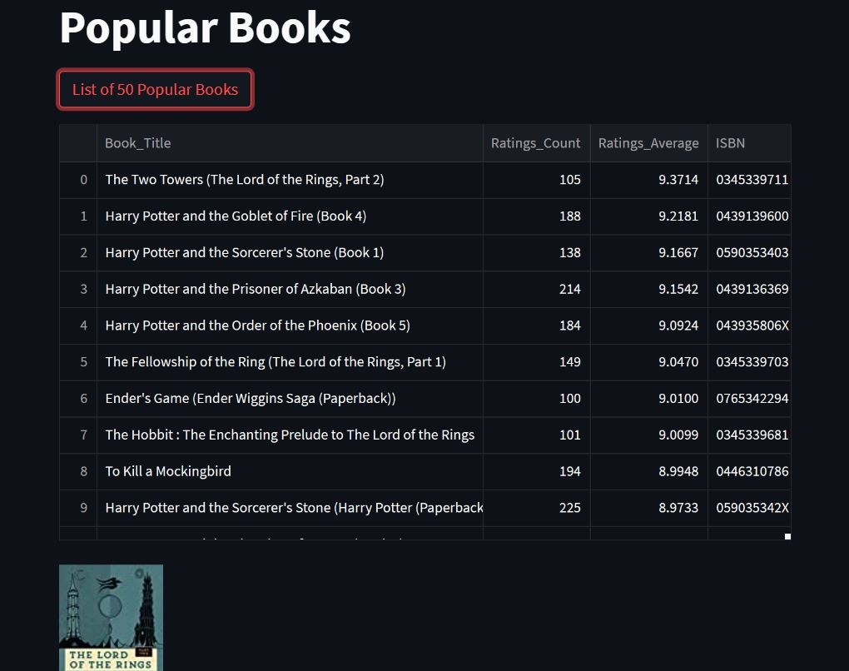

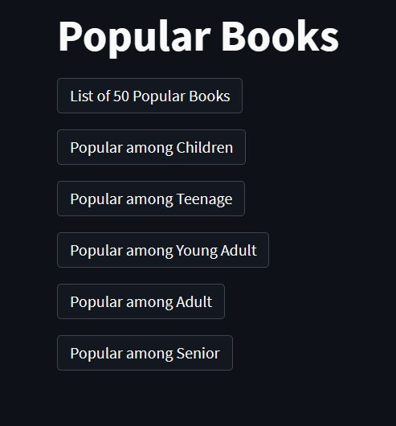
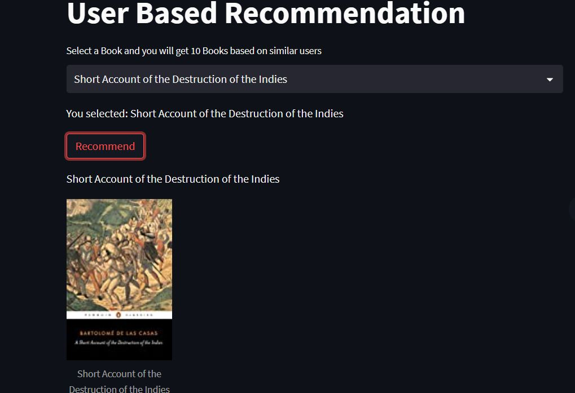
Deployment Using Streamlit

Slide 23
Challenges
• Three different datasets were required to make the final dataset. All three were large datasets.
• Age column having 40% of null values
• There are several books with multiple authors but they are different books with common book titles.
• The name of some authors with different publishers has the different format as some entries have a middle name or short form of name.
• There are many 0 in rating columns that reduces the average ratings when considered as actual rating.
• Some books have less number of ratings resulting in unfair rating distribution.
• Contrary to the above point the books with the higher number of ratings will have an unfair advantage in the final recommendation system as compared to those with less number of ratings.

Slide 24
Conclusions
The following are the important findings from the final dataframe.
• It has 230215 books
• Contains 97225 authors
• And 16115 publishers
• The readers from The USA have the highest presence as compared to any country or region.
• The majority of the population in the database is young Adults.

Slide 25
THANK YOU

